Slide 1
Smart traffic light management system
Nanabala Kiran Kumar (20181CCE0059)
Sai Suhaas G S (20181CCE0079)
Shravan N R(20181CCE0085)
Supriya T S (20181CCE0090)
Vyshnavi S (20181CCE0102)

Slide 2
INTRODUCTION
Smart traffic lights or Intelligent traffic lights are a vehicle traffic control system that combines traditional traffic lights with an array of sensors and artificial intelligence to intelligently route vehicle and pedestrian traffic.
They can form part of a bigger intelligent transport system.

Slide 3

PROBLEM
Waiting in signal to turn red light into green light even if there are no vehicles in opposite side because of fixed time in signal to change from one light to other may lead to traffic other side

Slide 4
SOLUTION
Setting signal time duration based on the number of vehicles using IR-Sensors
A constant duration will be fixed for normal traffic
If the vehicles are more the time duration will be increased

Slide 5
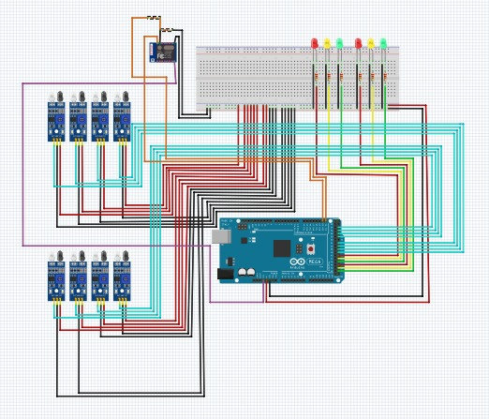
CIRCUIT

Slide 6

SOFTWARE COMPONENTS
Fritzing:-
Fritzing is an open-source hardware initiative that makes electronics accessible as a creative material for anyone. It offers a software tool, a community website and services in the spirit of Processing and Arduino, fostering a creative ecosystem that allows users to document their prototypes, share them with others, teach electronics in a classroom, and layout and manufacture professional PCBs.

Slide 7

Blynk:-
Blynk was designed for the Internet of Things. It can control hardware remotely, it can display sensor data, it can store data, vizualize it and do many other cool things. ... Blynk Server - responsible for all the communications between the smartphone and hardware.

Slide 8

Arduino IDE:-
The Arduino Integrated Development Environment is a cross-platform application that is written in functions from C and C++.
It is used to write and upload programs to Arduino compatible boards, but also, with the help of third-party cores, other vendor development boards.

Slide 9
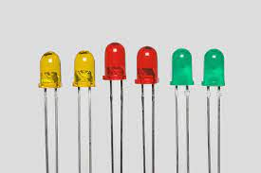
HARDWARE COMPONENTS
LED:-
LEDs (Light Emitting Diodes) are the latest development in the lighting industry. Made popular by their efficiency, range of color, and long lifespan, LED lights are ideal for numerous applications including night lighting, art lighting, and outdoor lighting.

Slide 10
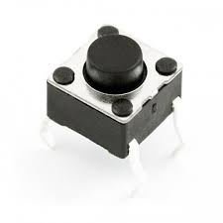
HARDWARE COMPONENTS
Push button:-
A Push Button switch is a type of switch which consists of a simple electric mechanism or air switch mechanism to turn something on or off.
Depending on model they could operate with momentary or latching action function.

Slide 11
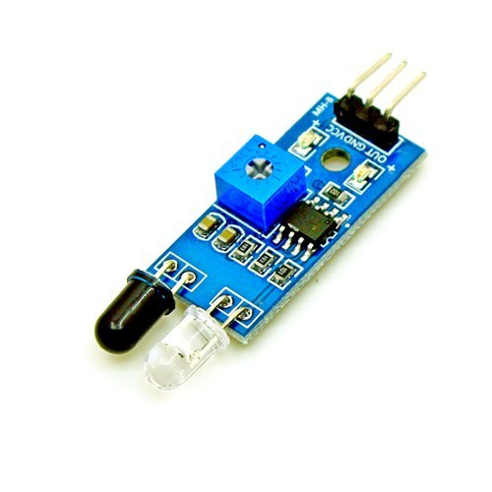
IR Sensor:-
An infrared (IR) sensor is an electronic device that measures and detects infrared radiation in its surrounding environment. Active infrared sensors both emit and detect infrared radiation. Active IR sensors have two parts: a light emitting diode (LED) and a receiver.

Slide 12
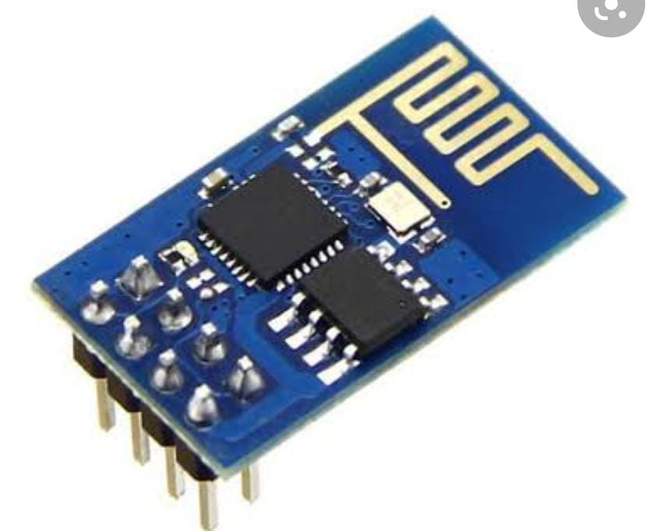
ESP8266 :-
The ESP8266 is a low-cost Wi-Fi microchip, with built-in TCP/IP networking software, and microcontroller capability, produced by Espressif Systems in Shanghai, China. The chip first came to the attention of Western makers in August 2014 with the ESP-01 module, made by a third-party manufacturer Ai-Thinker.

Slide 13
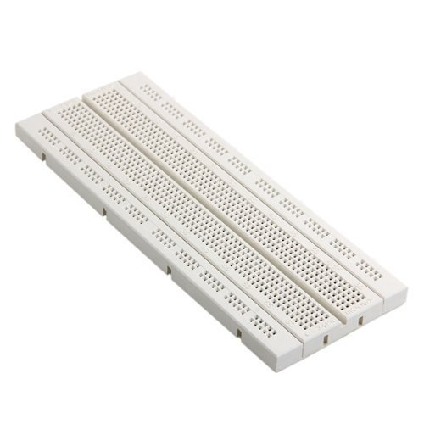
Breadboard:-
A breadboard is used to build and test circuits quickly before finalizing any circuit design. The breadboard has many holes into which circuit components like ICs and resistors can be inserted.

Slide 14
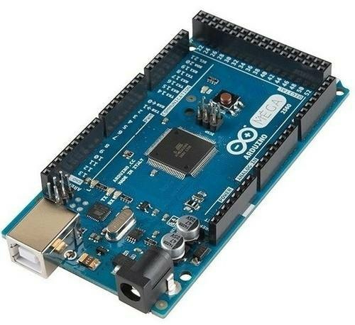
Arduino MEGA:-
The Arduino MEGA is designed for projects that require more I/O lines, more sketch memory and more RAM. With 54 digital I/O pins, 16 analog inputs and a larger space for your sketch it is the recommended board for 3D printers and robotics projects.

Slide 15
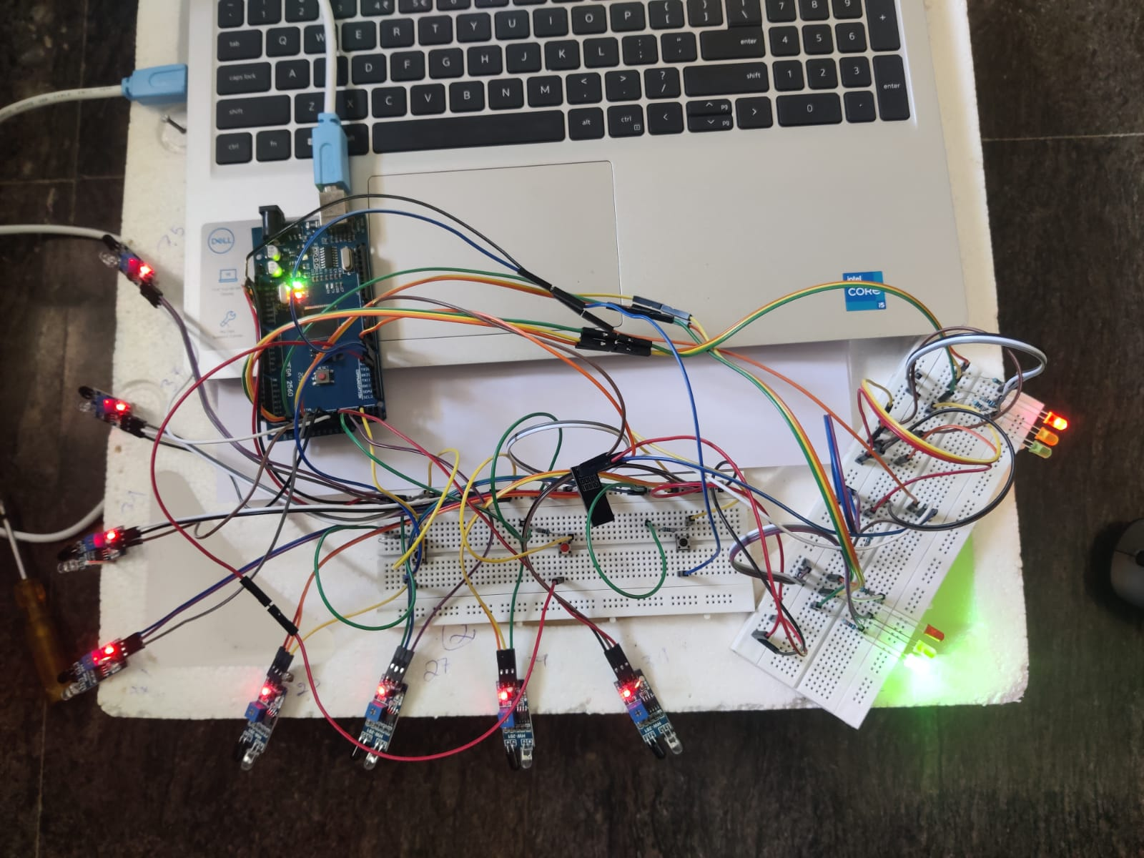

Slide 16
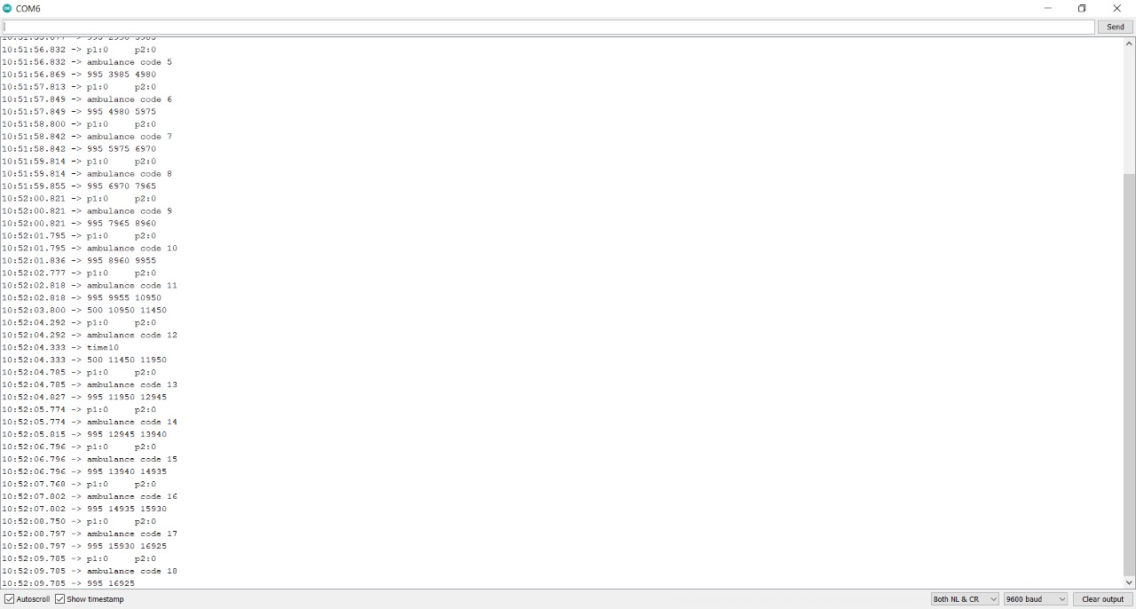

Slide 17
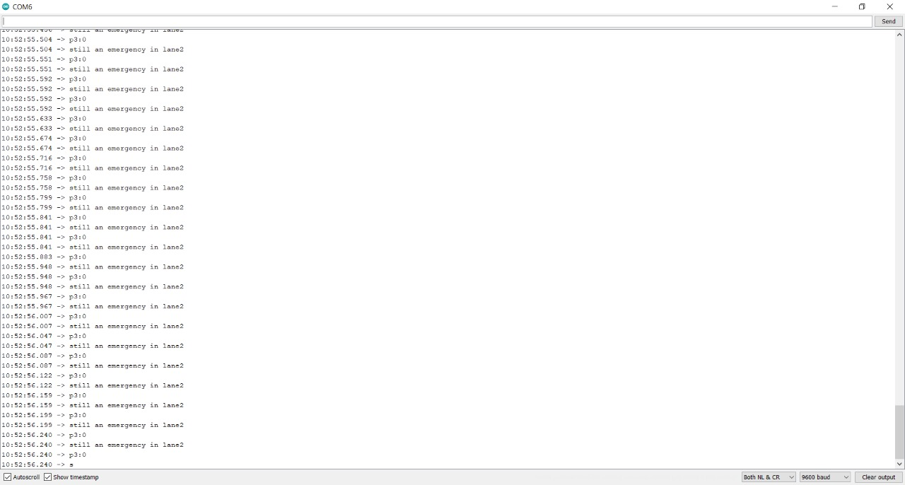

Slide 18
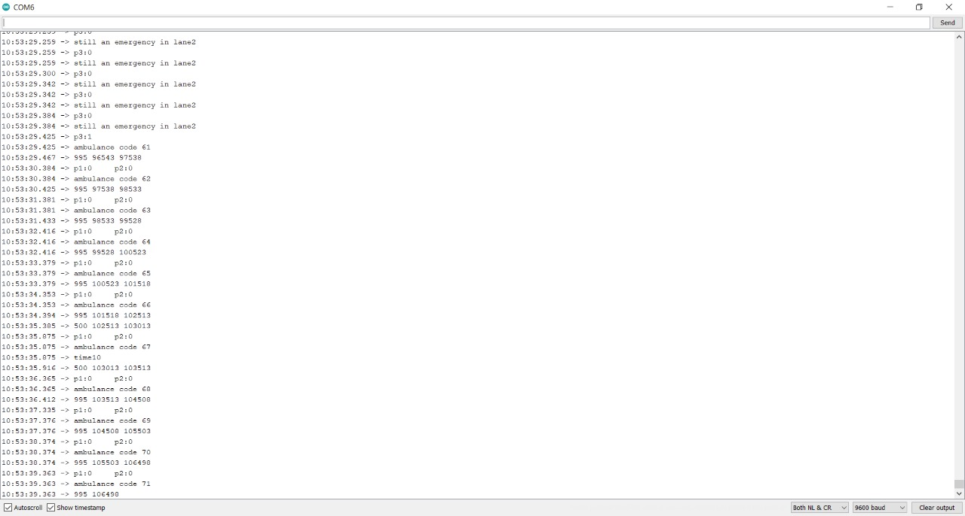

Slide 19
FUTURE SCOPE
Turning green lights on for a road during an emergency using a mobile app or from the control room.
Setting the time limits for the signal through mobile app or from the control room.
Overriding traffic controls from mobile or control room
Adding a signals for pedestrian movements

Slide 20
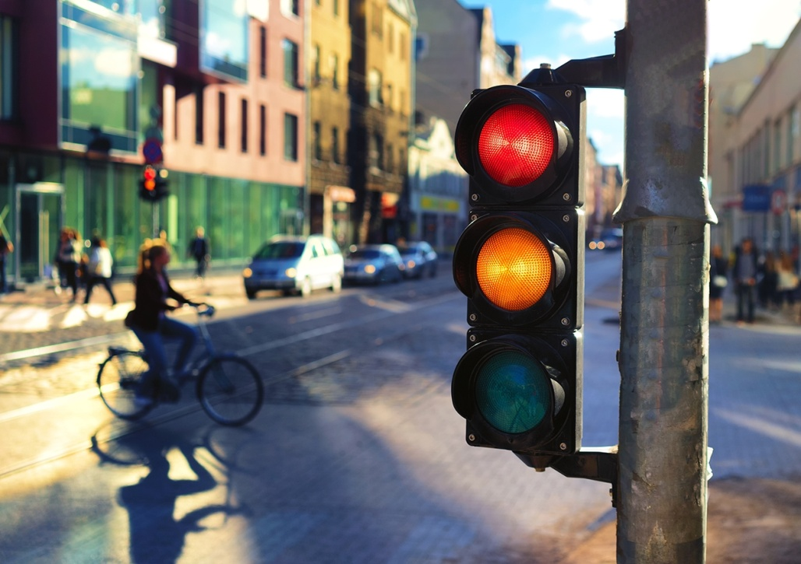
CONCLUSION:
We conclude that the traffic can be reduced by varying the time that is fixed to change the signal lights based on the number of vehicles on both the side

